Slide 1
The Beginnings
I need your help to rebuild my tribe’s village.

Slide 2
Essential Understandings:
What is area?
How does area model and multiplication relate?
How can area be used in building a colony?

Slide 3
Common Core/GPS Standards:
4NBT5: Multiply a whole number of up to four digits by a one-digit whole number, and multiply two two-digit numbers, using strategies based on place value and the properties of operations. Illustrate and explain the calculation by using equations, rectangular arrays, and/or area models.
4MD3: Apply the area and perimeter formulas for rectangles in real world and mathematical problems.
SS4H3: British Colonial America: The student will explain the factors that shaped British colonial America.

Slide 4
Where Do I Start?
Area
Notes:
What have you done with the area model? You covered the entire surface of the rectangle or square. You are finding the total surface area of the figure. To find area, what do we do? Length x Width

Slide 5
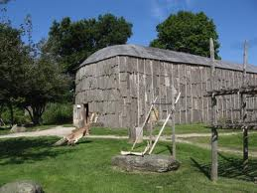
Building a house
Size?
15 feet long and 6 feet wide

Slide 6
15 feet long and 6 feet wide

Slide 7
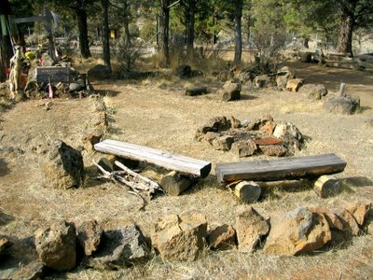
Area used for Ceremonies
Size?
52 feet long 13 feet wide

Slide 8
52 feet long and 13 feet wide

Slide 9
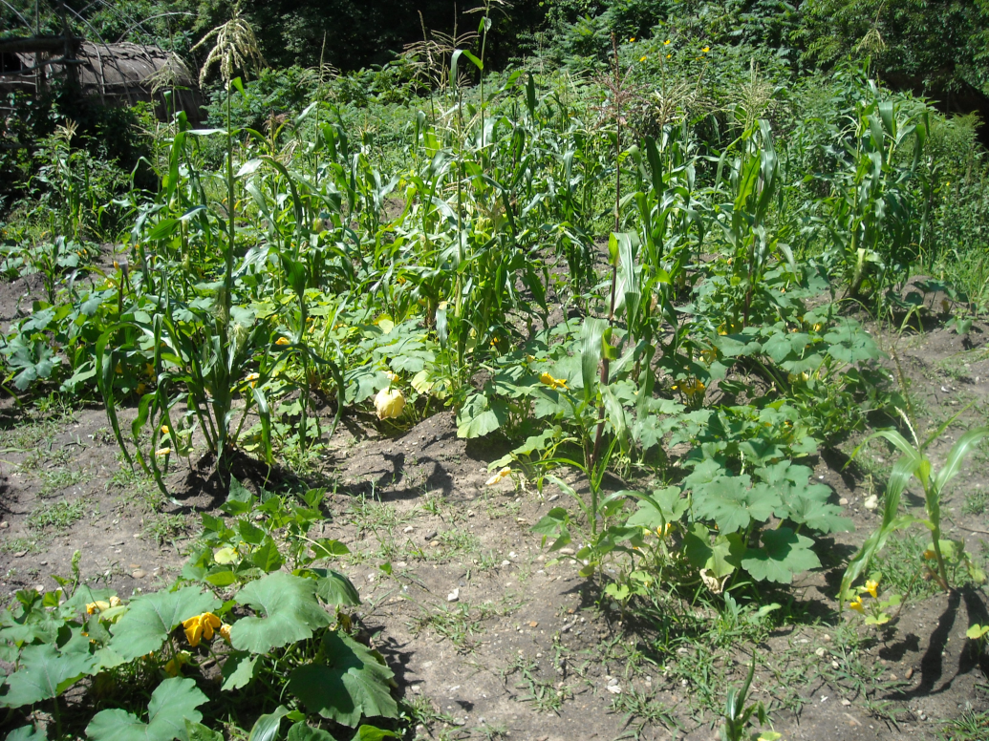
Garden for corn, squash, and bean plants
34 feet long and 12 feet wide

Slide 10
34 feet long and 12 feet wide

Slide 11
Methods you can use to help build your colony…
Lattice
Traditional
Magic Quadrilateral
Area Model (what we have worked on today)

